Slide 1

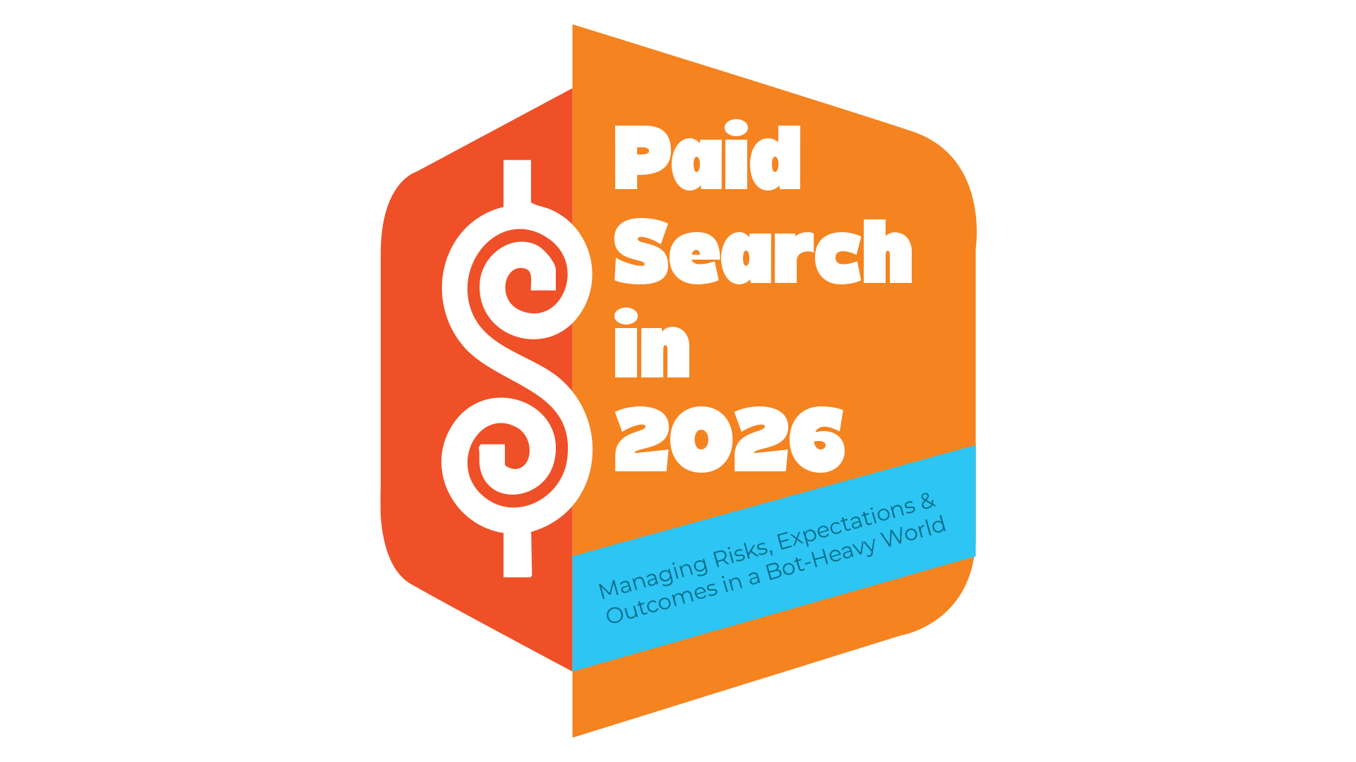

Slide 2

Why are we training on this topic?
Inflated paid search analytics are leading clients to believe paid search is the best avenue for their marketing investments.
Clients are asking sellers to move budgets from branding channels to paid search because of the inflated numbers they are seeing in the reporting.
Why do some clients and sellers have a bias towards Paid Search?
Clear attribution
Easy to show reporting
Pressure on sellers to drive ROI

Slide 3

Paid Search by numbers
Google ad spend rose by 17% YOY in 2024
That same year, clicks went from +8% to +4% YOY
CPC growth is now outpacing click growth
Advertisers are paying more just to maintain volume YOY
Inflated Bot Traffic
Generative AI
Changing Buyer Habits
…
What is causing the shift?

Slide 4

1. Inflated Bot Traffic
AI-driven bots now represent a majority of web traffic
Fraud and invalid clicks inflate:
  CTR
  Lead volume
  Performance signals
Why this matters
  Metrics look strong before outcomes are validated
  Budget decisions get made on unreliable data
  Diminishes the value of other channels

Slide 5
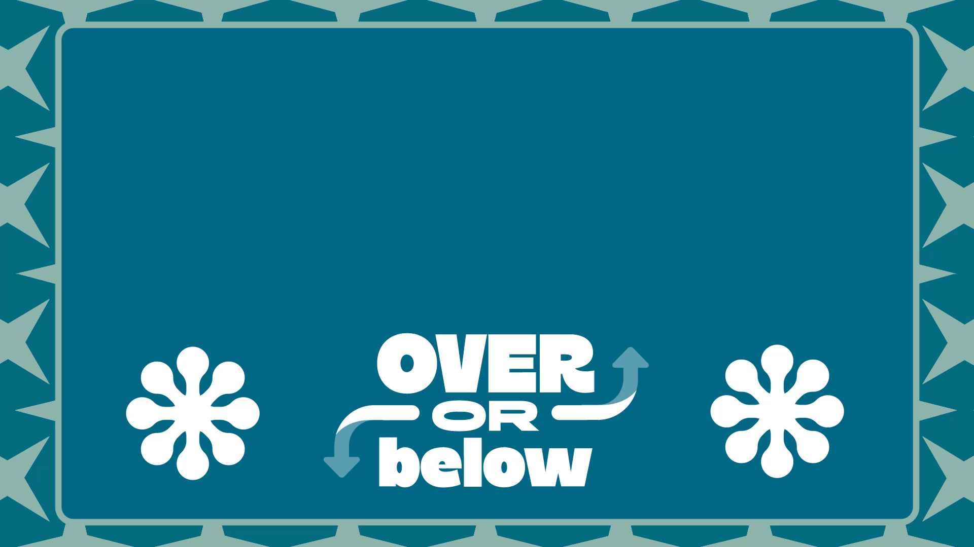

Slide 6

2. Generative Ai Risk
Generative AI answers more questions without a click
Buyers do more research before ever visiting a site
Search is becoming more answer driven and less exploration driven.
Why this matters
Paid search centric campaigns captures buyers later in the journey with fewer chances to:
  Educate
  Differentiate
  Build preference

Slide 7

3. “Tire Kickers”
Ai is taking over the buyer’s research phase
By the time someone gets to your ad, they are most likely price shopping
  Which may lead to unnecessary price cuts
Why Branding is so important to avoid this:
  Gives potential buyers an opportunity to establish a preference, before they click on your ad
  Reduces price sensitivity
  Buyers are educated before reaching out = better quality
  Consistent messaging across multiple channels, keeps your funnel full

Slide 8

How
to Pivot

Slide 9
1. Moving from a single KPI to business outcomes
Shift the Conversation From:
Leads to Qualified Leads
Cost per lead to Cost per Booked Job / Sale
Channel performance to Total marketing contribution
How Branding Channels Supports This
Increases:
  Branded search volume
  Stronger SEO
  Click-through rates
  Conversion rates across all channels
Lowers:
  Cost per acquisition over time
  Dependence on bottom-funnel tactics

Slide 10
2. Managing Expectations Upfront
Multi-channel marketing and frequency
Paid search…
  Is competitive
  Is vulnerable to invalid traffic
  Works best when paired with other channels
                Not every lead is equal (quality > quantity)
      Early volume does not guarantee long-term efficiency
Set the KPI's for the campaign upfront (and remind them often)
  Business outcomes
  Sales feedback
  Lead quality scoring

Slide 11

3. Stand on AIM as the line of defense
Focuses spend on:
  Known site visitors
  Look-alike audiences
  In-market and intent-driven users
Reduces exposure to:
  Random traffic
  Broad, low-intent searches
Improves:
  Lead quality
  Conversion efficiency
  Cross-channel performance
Optimization tools like AIM can:
Increase conversions up to 14% at a similar CPA
Decrease overall ad spend by 12%

Slide 12

What we are saying…..
Paid search is an important and effective channel (however not sustainable as a lone strategy)
Paid search works best when it captures existing demand
Multi-channel strategies produce:
Branding:
Improves paid search efficiency
Increases trust, intent and credibility
Protects long-term outcomes
Our role is to guide clients, not simply respond to requests
What we are NOT saying.....
Paid search doesn’t work
You shouldn’t sell paid search
Branding replaces performance marketing
        Better lead quality
  Stronger conversion rates
  More sustainable growth

Slide 13
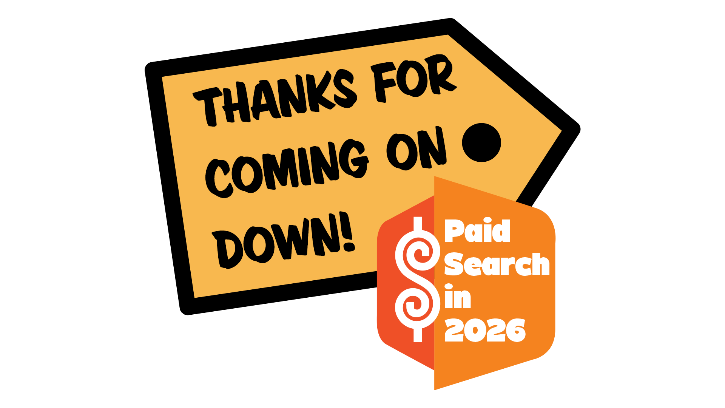

Slide 14
ACTIVITY: The Stat is Right (Price is Right style). The goal is to get the DMDs to engage early in the conversation. Lindsey- feel free to change the game, but these are the stats I want to hammer on to set the stage.
OVER OR BELOW: Ai Bot traffic makes up 40% of all web traffic (answer: 52.3%)
OVER OR BELOW: By 2028, bot traffic digital ad waste is projected to soar toward $145 billion (answer: $172 billion)
OVER OR BELOW: 18% of global digital ad spend was lost to ad fraud (answer: 22%)
OVER OR BELOW: $1 of marketing budget is lost to ad fraud for every $2 (answer: $3)

Slide 15
Note:
I want to create a one-sheet/takeaway doc with this info:
(let me know if it should be in here instead)
Follow this link:
Director Messaging Guide: Paid Search in 2026

Slide 16
The risk of making SEM your bread and butter:
Platform and Data Risk
More dependent of Google's algorithm changes
Exposed to more fraud
Excess bot traffic skews analytics that help us make informed decisions
Generative Ai Risk
Generative AI answers more questions without a click
Buyers do more research before ever visiting a site
Search is becoming more answer driven and less exploration driven.
Why this matters:
Paid search captures buyers later in the journey with fewer chances to:
  Educate
  Differentiate
  Build preference
Strategic Risk
Moving dollars off branding channels shrinks your pool of potential
Quantity is prioritized over quality
Sellers become reactive order takers (vendors), not consultants ​
Falling into the KPI Trap:​
    Number of leads become the north star​
    Quality and conversion rate get deprioritized​
    More pressure gets put on branding channels to produce, because they don't show "leads"​

